Slide 1
Generalization Ability
Notes:
The network we used today is usually too larg
VC
Part I
Part II

Slide 2
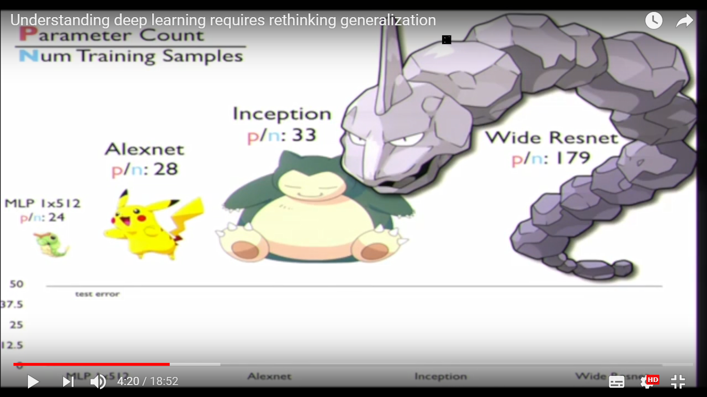
We use very large network today
Source of image: https://www.youtube.com/watch?v=kCj51pTQPKI

Slide 3
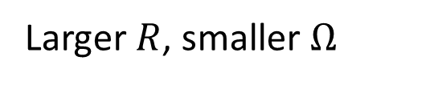

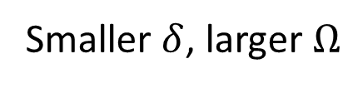
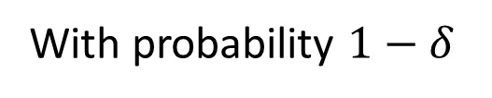


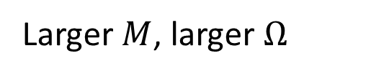
Generalization Gap
機器學習基石
https://youtu.be/XxPB9GlJEUk
No matter the data distribution
With probability $1−δ$
$$E_{train}≤$$
$$E_{test}$$
$$≤E_{train} +Ω\left(R,M,δ\right)$$
Smaller $δ$, larger $Ω$
R is the number of training data
Larger $R$, smaller $Ω$
M is the “capacity” of your model
Larger $M$, larger $Ω$
(“size” of the function set)
How to measure the “capacity”?
VC dimension (d_{VC})
Notes:
Two measures of model complexity are Rademacher complexity and Vapnik‑Chervonenkis (VC) dimension. Unfortunately, for the deep learning function f known bounds based on Radamacher complexity grow exponentially in depth of DNN. Which contradicts practical observation that deeper nets fit better to the training data and achieve smaller empirical errors.Similarly, the generalization gap bound based on VC dimension grows linearly in the number of trainable parameters and cannot account for the practical observations with deep learning. In other words, these two bounds are too conservative.

Slide 4
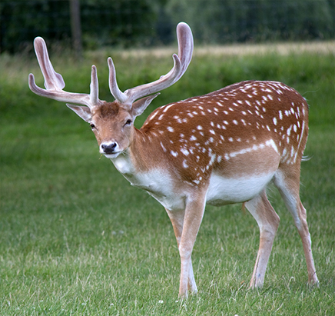

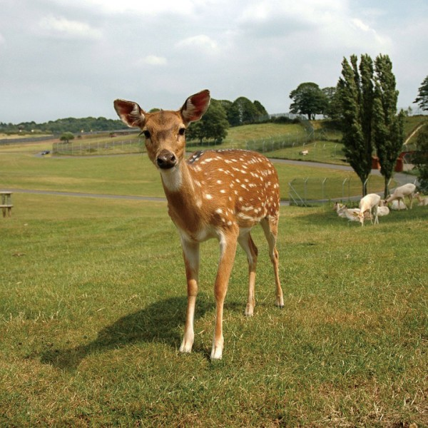
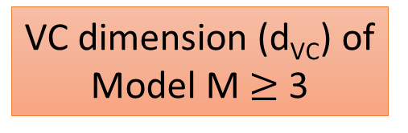
Given 3 data points
Random label (故意亂教)
Model M can always achieve 0% error rate
(亂教 Model M 都學得會)
VC dimension (d_{VC}) of Model M $≥$ 3
e.g. linear model
馬
鹿

Slide 5
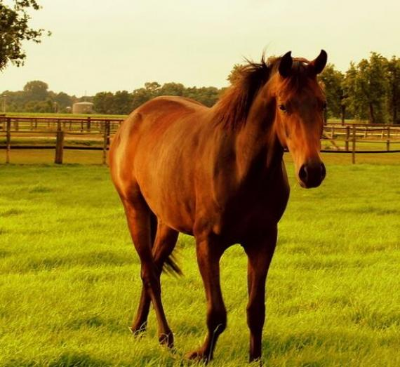
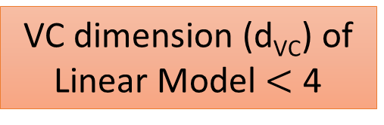
Random label (故意亂教)
There are some cases linear model can not learn.
(知道是來亂的，所以不學)
VC dimension (d_{VC}) of Linear Model $<$ 4
馬
鹿
鹿
馬
Given 4 data points

Slide 6
What is the capacity of deep models?
Inception model on the CIFAR10
Chiyuan Zhang, Samy Bengio, Moritz Hardt, Benjamin Recht, Oriol Vinyals, “Understanding deep learning requires rethinking generalization”, ICLR 2017
Notes:
The CIFAR-10 dataset consists of 60000 32x32 colour images in 10 classes, with 6000 images per class. There are 50000 training images and 10000 test images

Slide 7
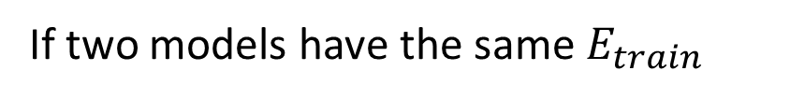
Overparameterized Network?
No matter the data distribution
With probability $1−δ$
$$E_{test}$$
$$≤E_{train} +Ω\left(R,M,δ\right)$$
Smaller $δ$, larger $Ω$
R is the number of training data
Larger $R$, smaller $Ω$
M is the “capacity” of your model
Larger $M$, larger $Ω$
(“size” of the function set)
Select the one with smaller capacity
If two models have the same $E_{train}$
Demo
Notes:
Two measures of model complexity are Rademacher complexity and Vapnik‑Chervonenkis (VC) dimension. Unfortunately, for the deep learning function f known bounds based on Radamacher complexity grow exponentially in depth of DNN. Which contradicts practical observation that deeper nets fit better to the training data and achieve smaller empirical errors.Similarly, the generalization gap bound based on VC dimension grows linearly in the number of trainable parameters and cannot account for the practical observations with deep learning. In other words, these two bounds are too conservative.

Slide 8
Overparameterized Network?
MNIST
https://arxiv.org/abs/1706.08947

Slide 9
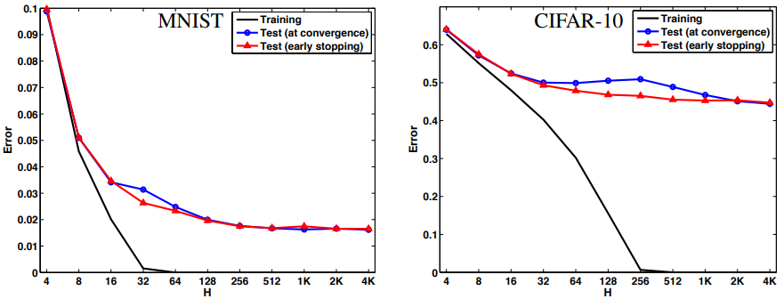
Overparameterized Network?
https://arxiv.org/pdf/1412.6614.pdf
Notes:
2 hidden
Behnam Neyshabur, Ryota Tomioka, Ruslan Salakhutdinov, Nathan Srebro, “Geometry of Optimization and Implicit Regularization in Deep Learning”, arXiv, 2017

Slide 10
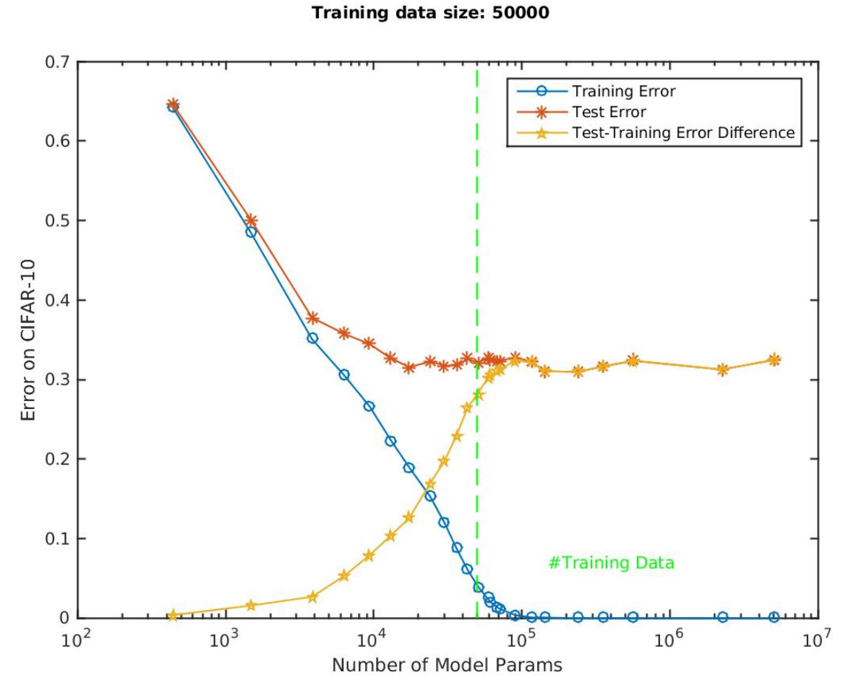
Overparameterized Network?
https://arxiv.org/abs/1801.00173
Notes:
Tomaso Poggio, Kenji Kawaguchi, Qianli Liao, Brando Miranda, Lorenzo Rosasco, Xavier Boix, Jack Hidary, Hrushikesh Mhaskar, “Theory of Deep Learning III: explaining the non-overfitting puzzle”, arXiv, 2017

Slide 11
CIFIR-10, 100% training accuracy
https://arxiv.org/pdf/1802.08760.pdf

Slide 12
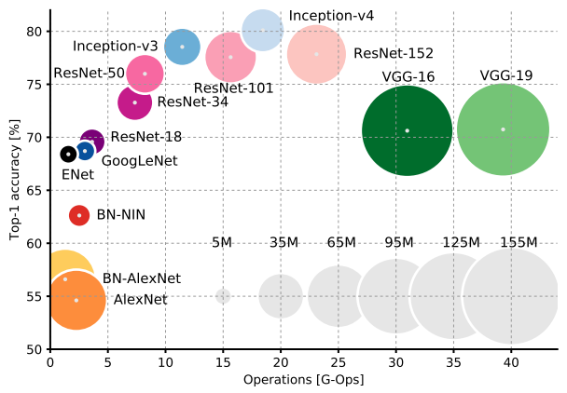
https://arxiv.org/abs/1605.07678

Slide 13
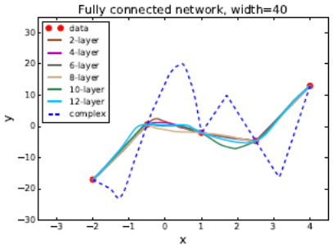
Network regularizes itself?
https://arxiv.org/pdf/1706.10239.pdf

Slide 14
Concluding Remarks
The capacity of deep model is large.
However, it does not overfit!
The reason is not clear yet.

